Slide 1

Live Typing
Hernán A. Wilkinson
@hernanwilkinson
agile software development & services

Slide 2
Live Environment + Dynamically Typed to get Live Type Information to improve the tools

Slide 3
How does it work: Changes in the VM to store type info Changes in core classes to keep that info Tools to use that info

Slide 4
Changes in the VM
Every time an object is assigned to a variable, the VM stores the class of that object in an array of types for that variable
Every time a method gets activated, it does the same as in 1) but with arguments
When a method returns, it stores the return type as in 1)

Slide 5
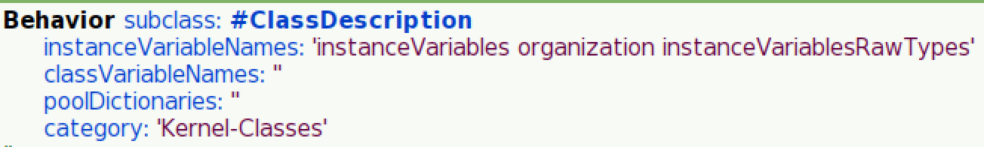
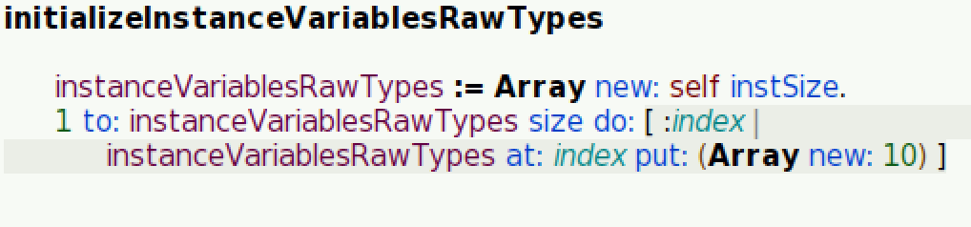
Instance variables

Slide 6
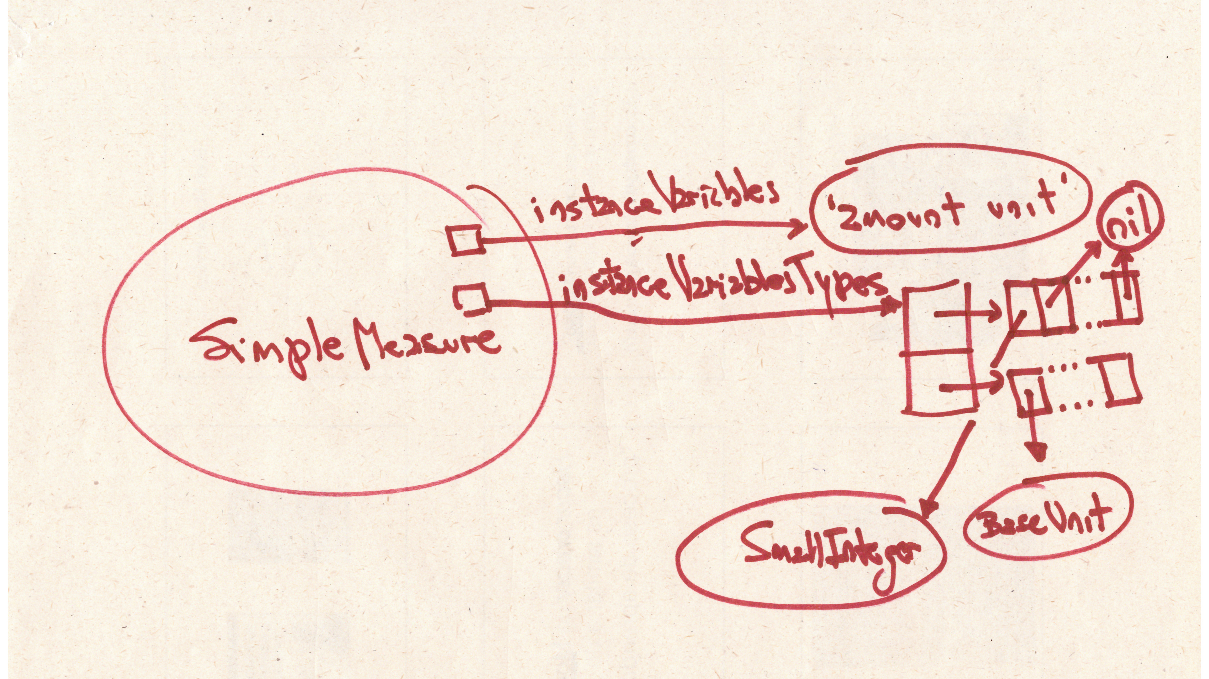
Instance variables
New inst. var in ClassDescription: instanceVariablesRawTypes

Slide 7
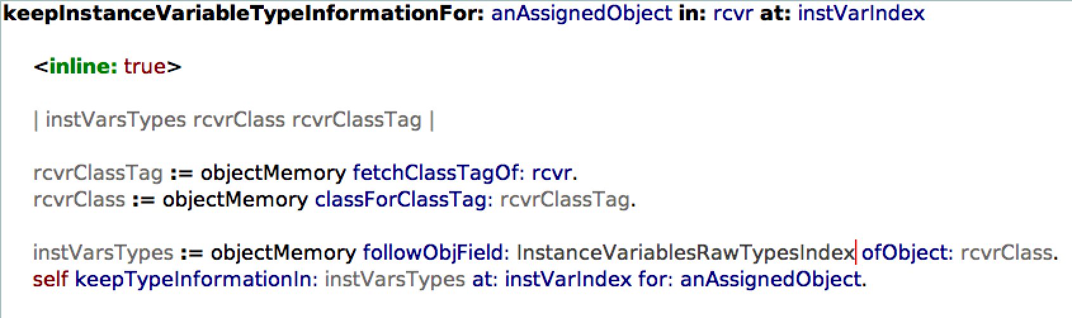
Instance variables – VM Change
Every time a newObject is assigned to a variable, the VM stores ”newObject class” into “instanceVariablesRawTypes at: (self indexOf: variable)”

Slide 8
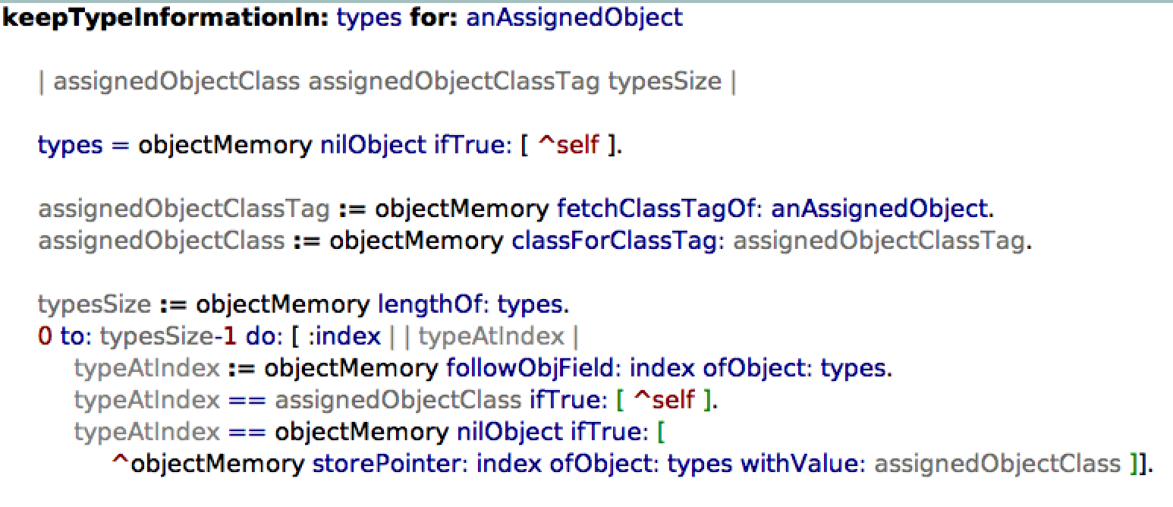
Instance variables – VM Change

Slide 9
Instance variables
instanceVariablesRawTypes can be nil.
It means we don’t want to store types for that class instance variables
instanceVariablesRawTypes at: instVarIndex
Can be an empty array if we don’t want to store types for that instance variable
It can have different sizes per instance variable to adjust memory consumption and speed

Slide 10
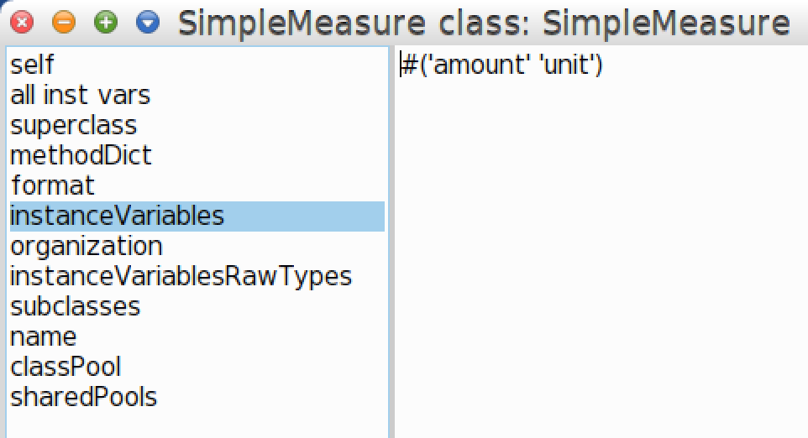
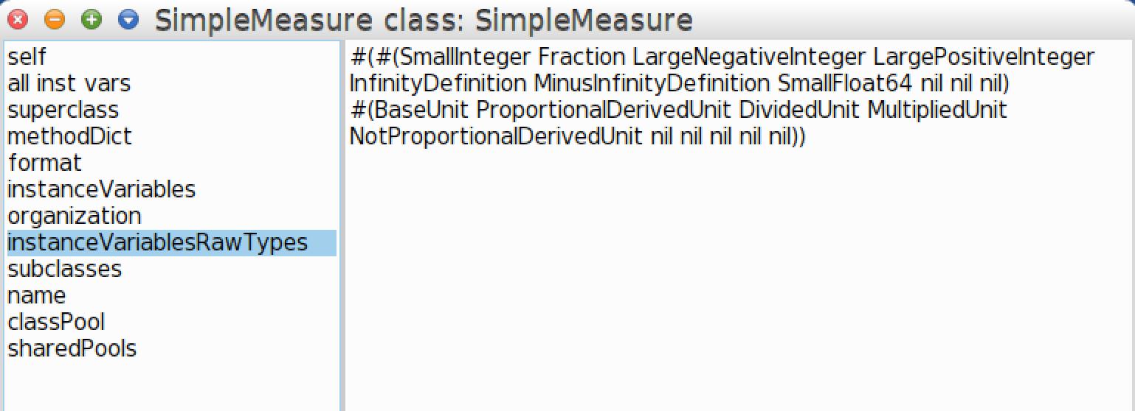
SimpleMeasure

Slide 11
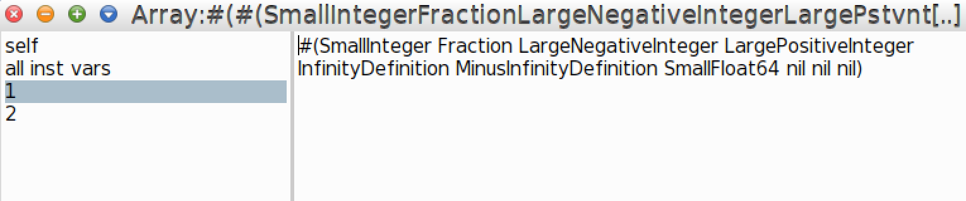
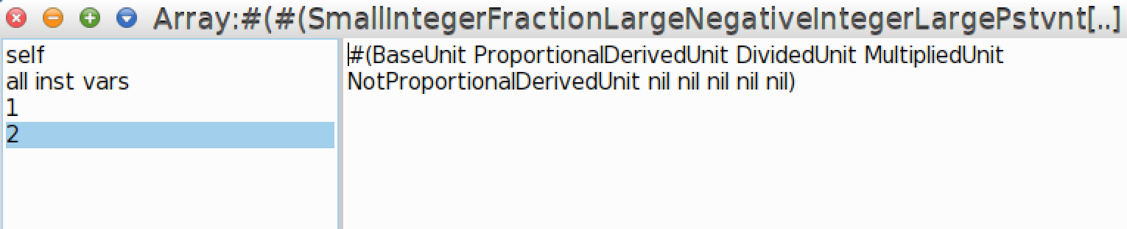
SimpleMeasure instanceVariablesRawTypes

Slide 12
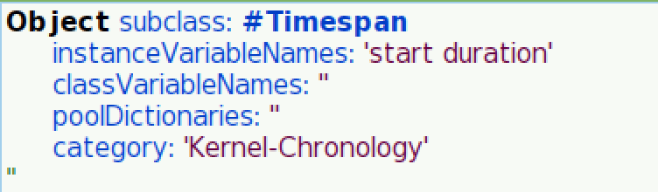
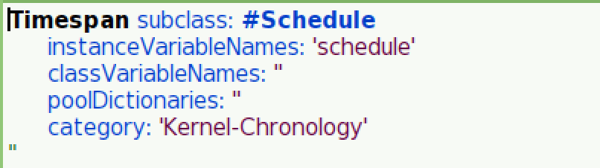
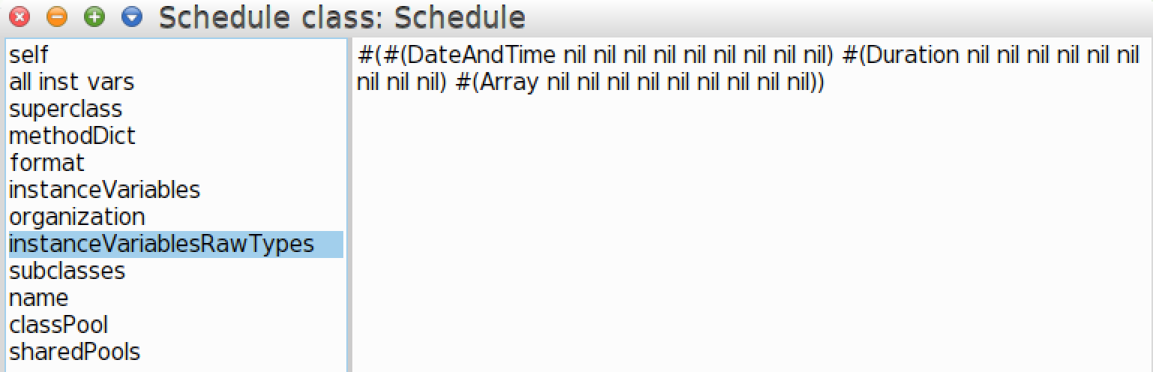
Schedule

Slide 13
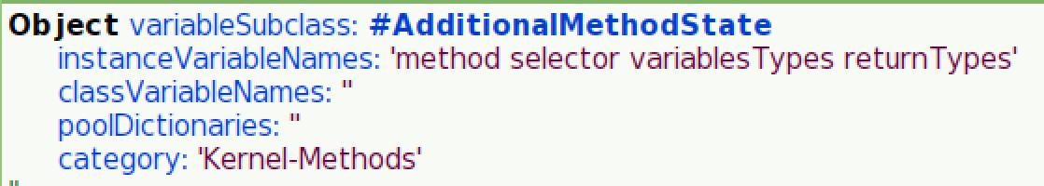
Method Type Information
New AdditionalMethodState instance variables:
variablesTypes: Keeps arguments and temporaries types. Same structure as instanceVariablesRawTypes
returnTypes: Keeps return types

Slide 14
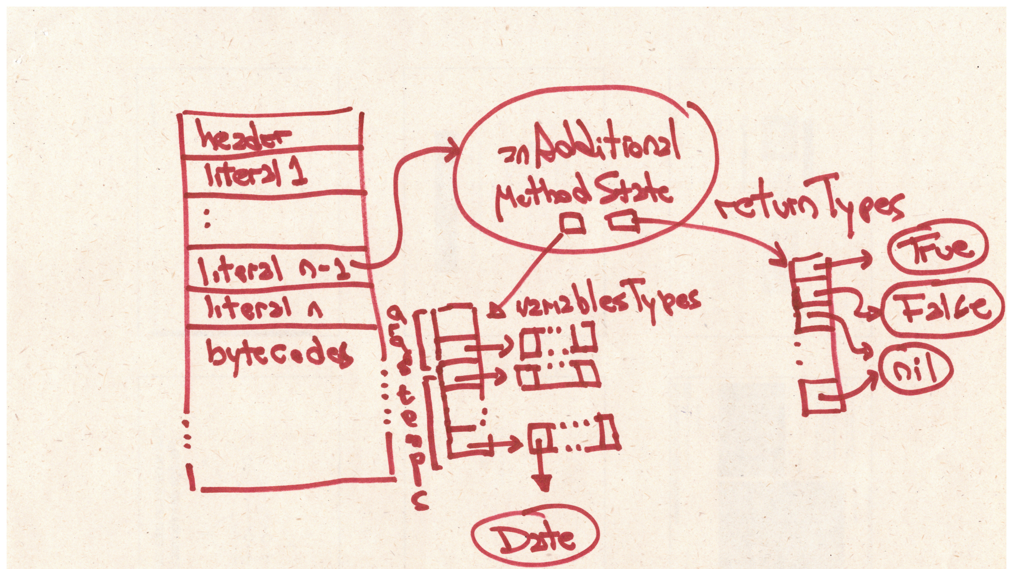

Slide 15
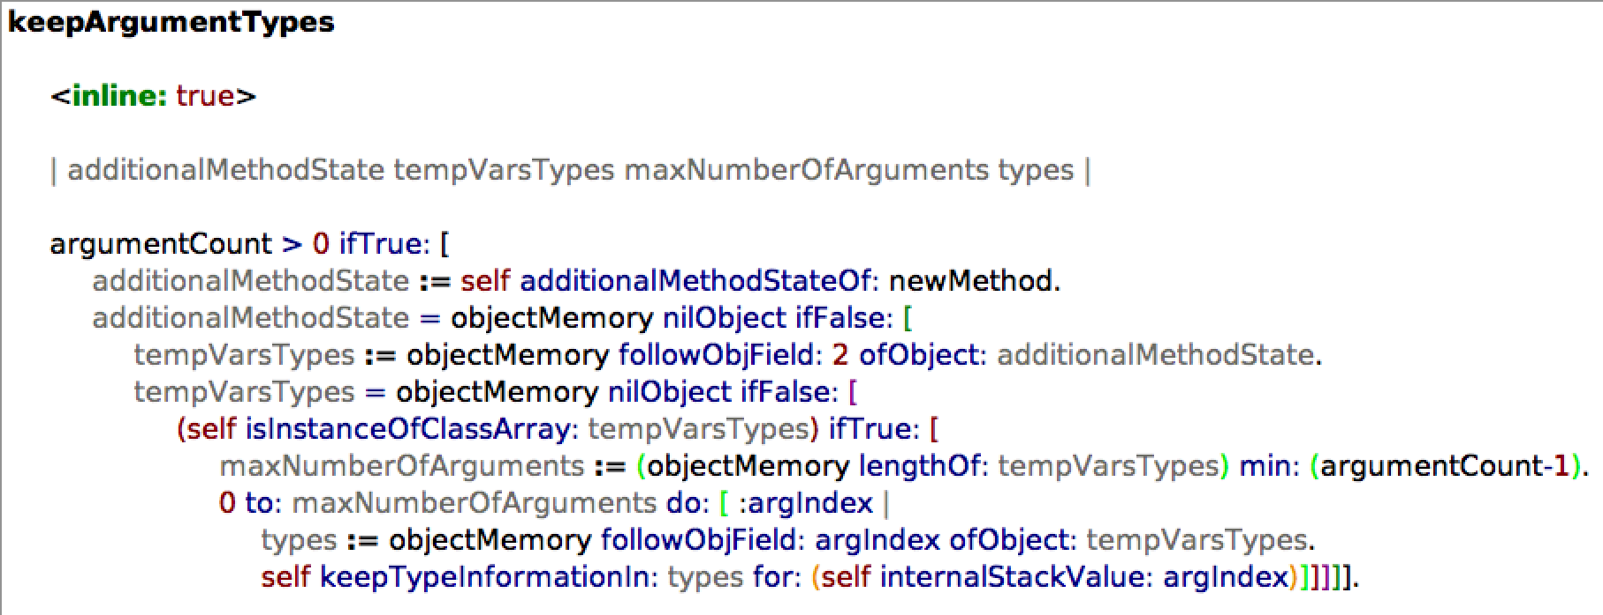
Method Type Information – VM Changes

Slide 16
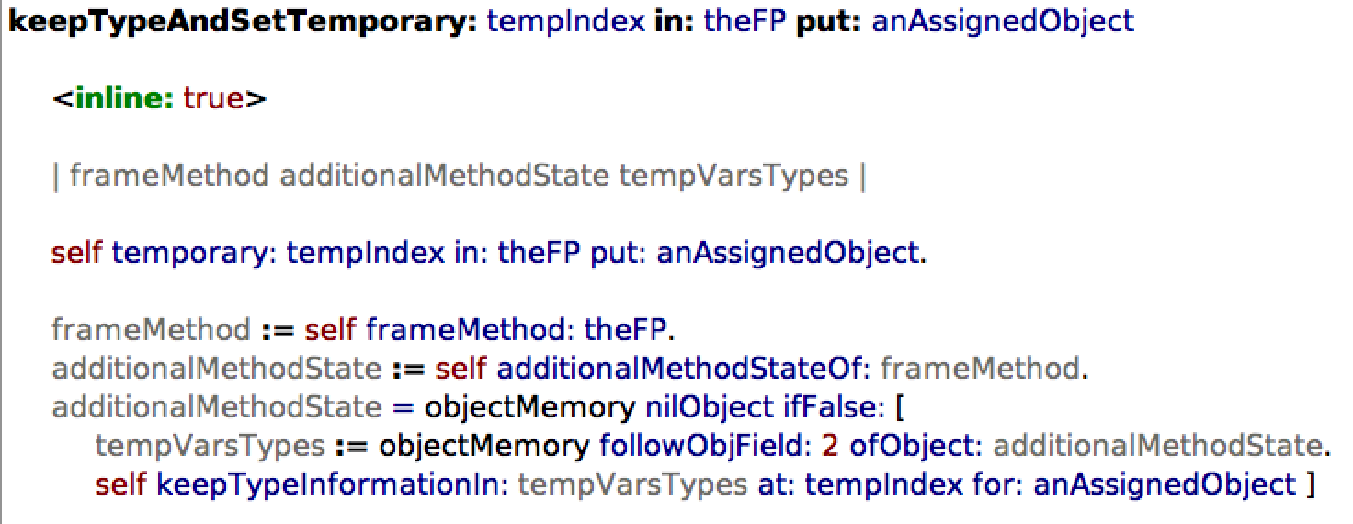
Method Type Information – VM Changes

Slide 17
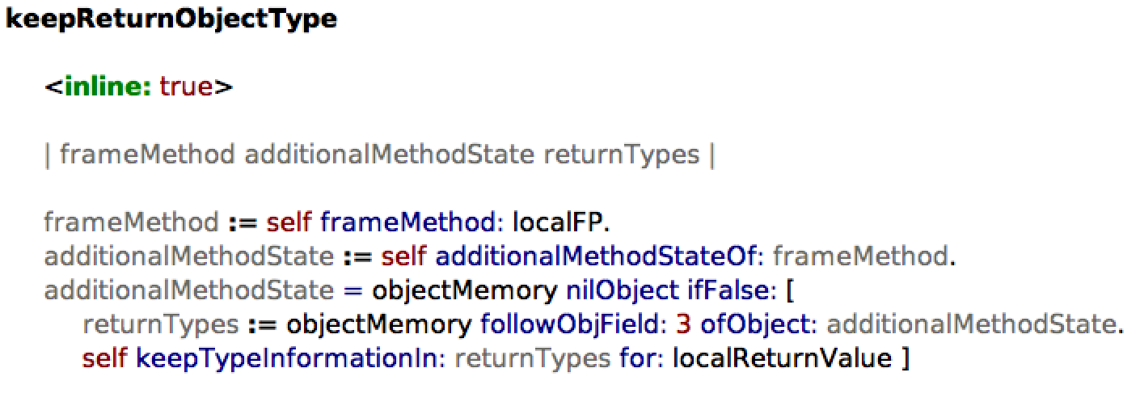
Method Type Information – VM Changes

Slide 18
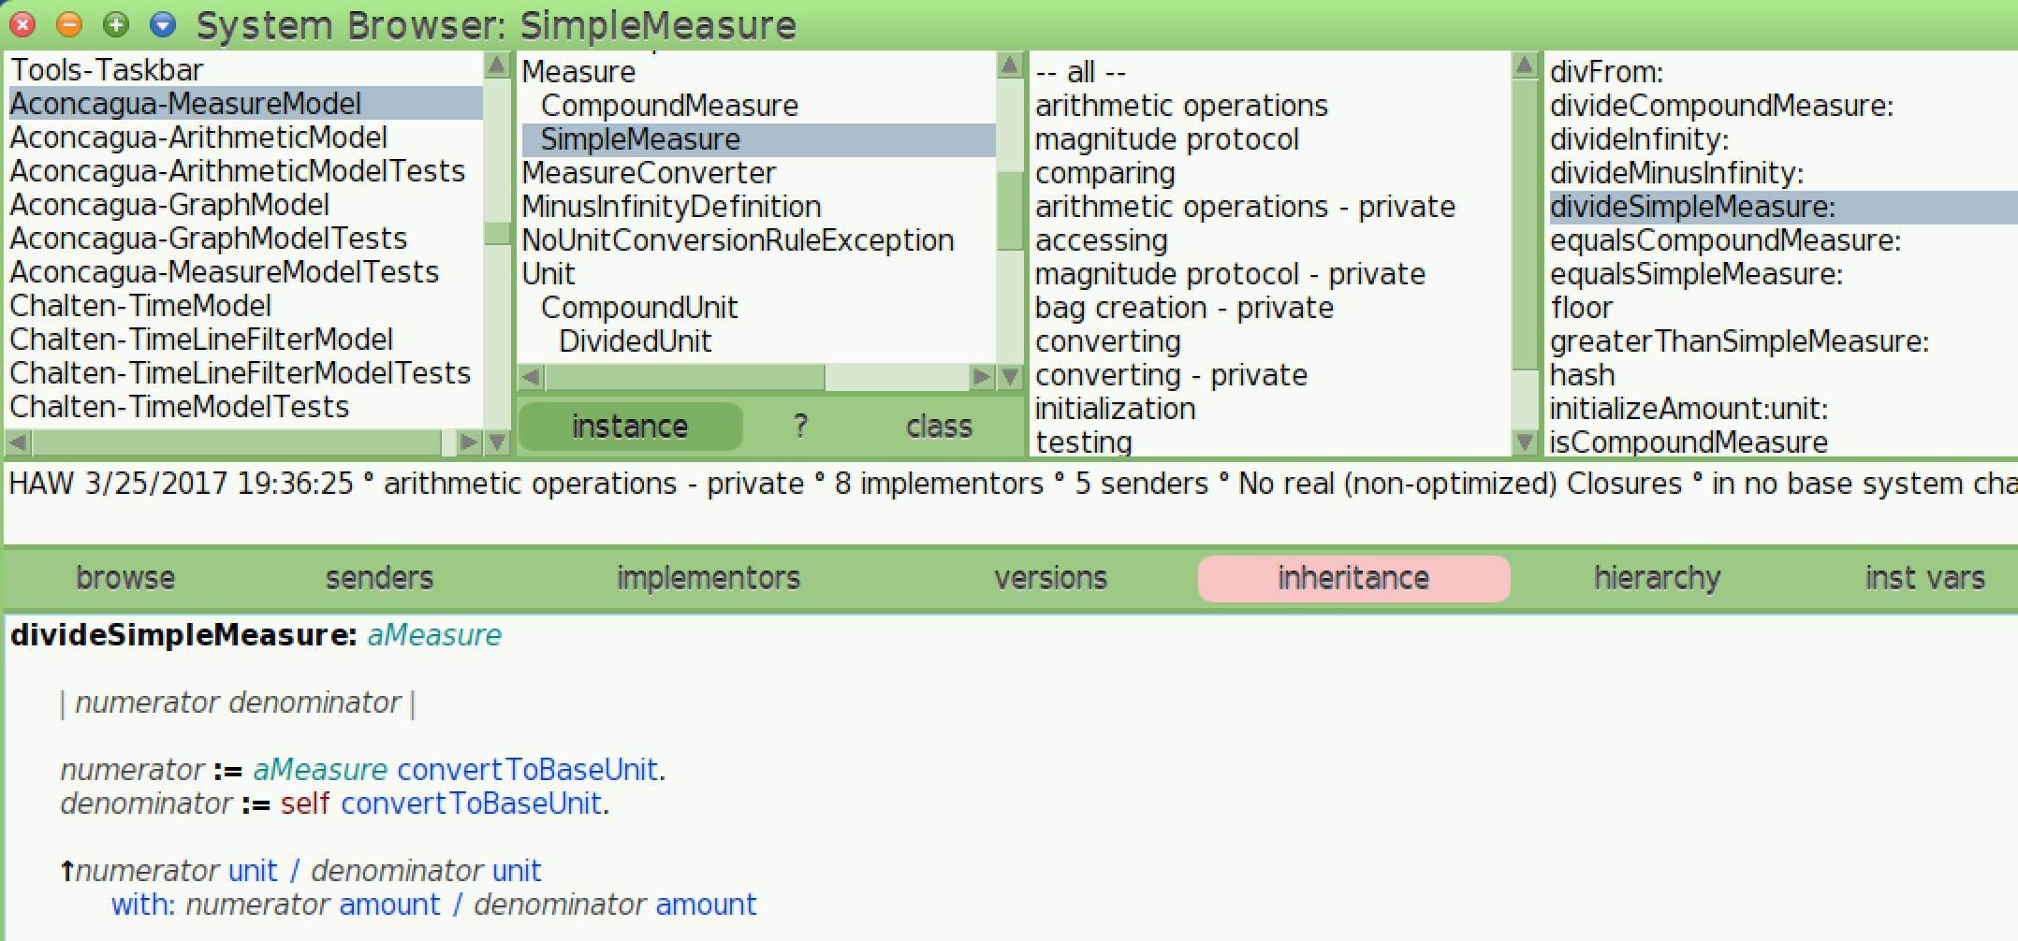
SimpleMeasure>>#divideSimpleMeasure:

Slide 19
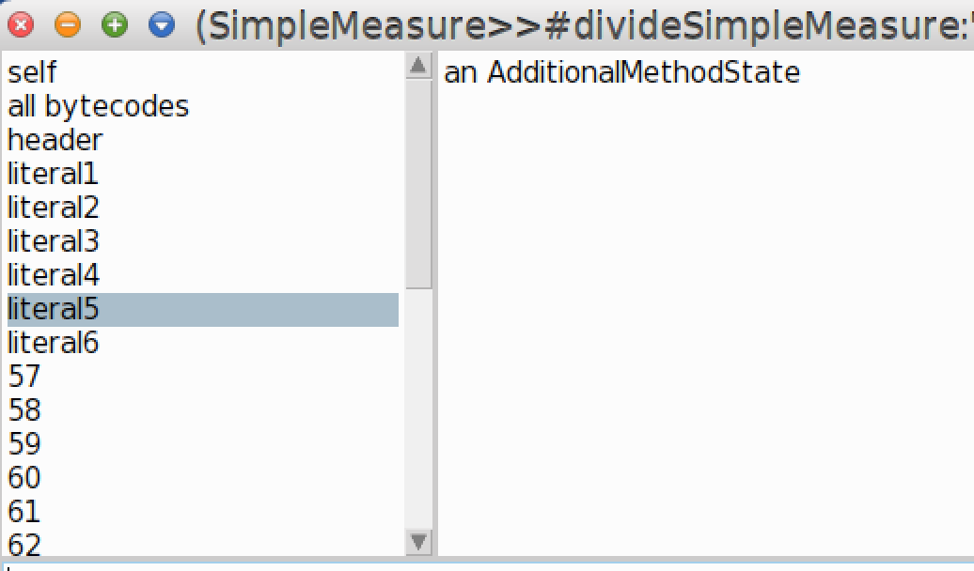
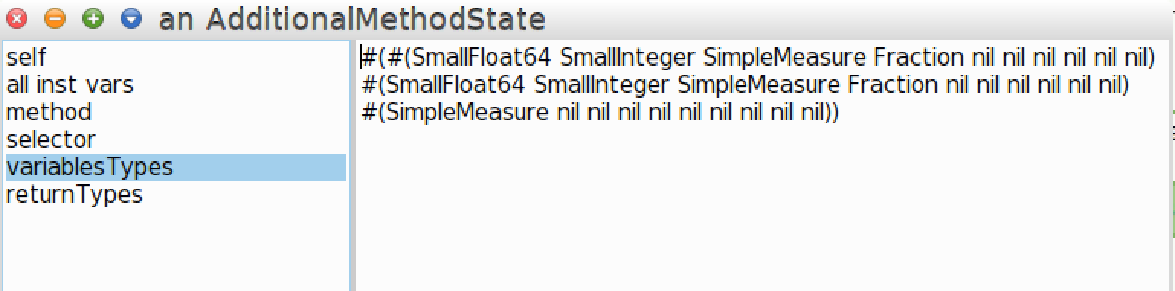
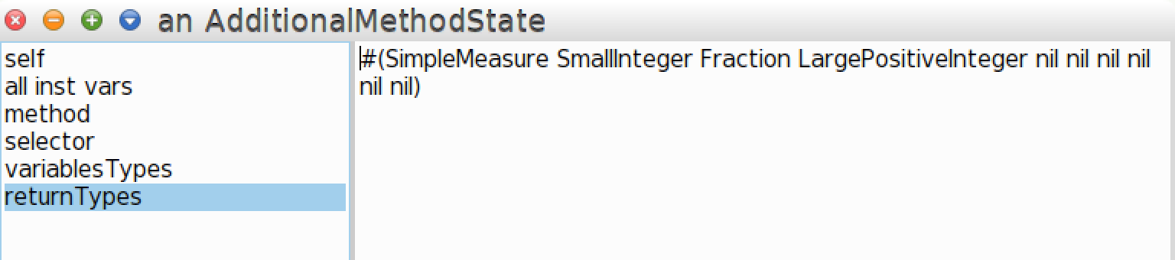
SimpleMeasure>>#divideSimpleMeasure:

Slide 20
Some statistics

Slide 21
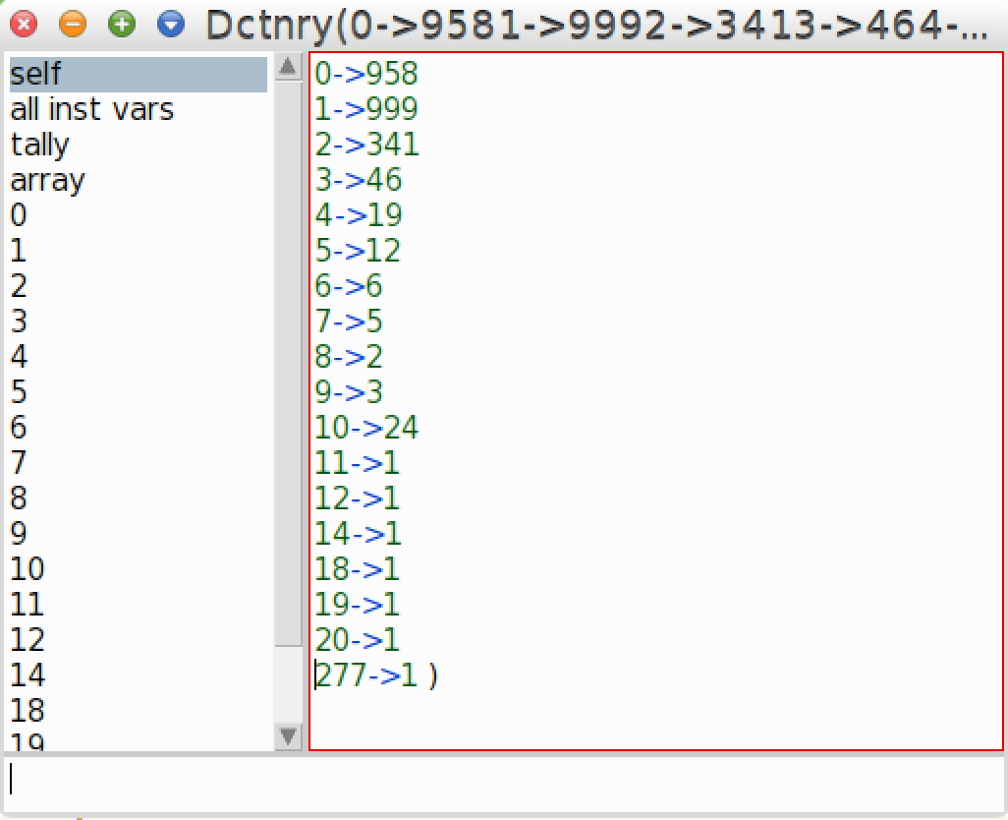
InstanceVariablesTypes numberOfTypesForAll

Slide 22
InstanceVariablesTypes numberOfTypesForAll
?

Slide 23
InstanceVariablesTypes numberOfTypesForAll
superclass!

Slide 24
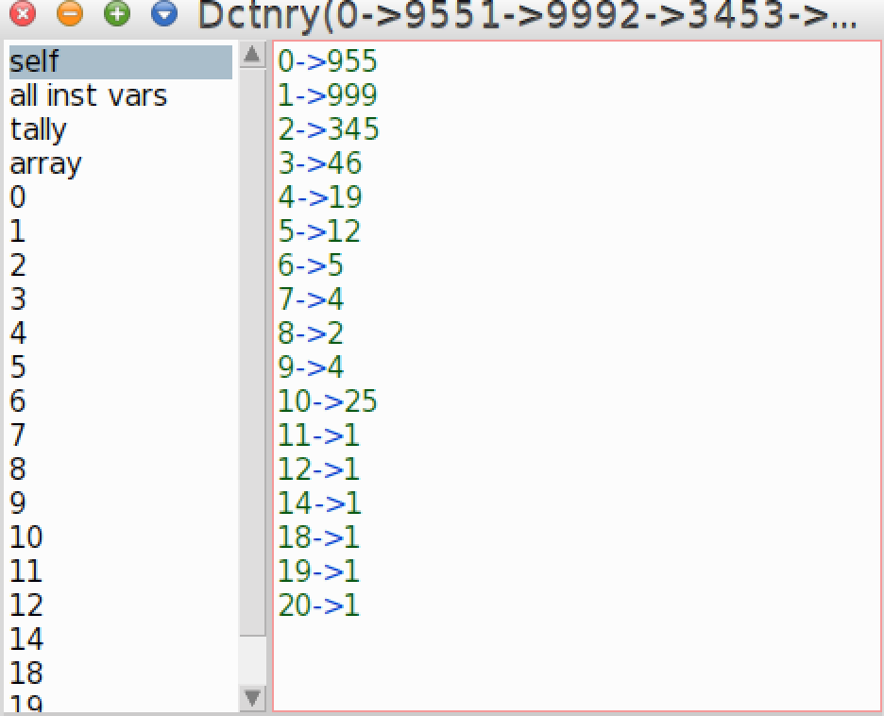
InstanceVariablesTypes numberOfTypesForAll

Slide 25
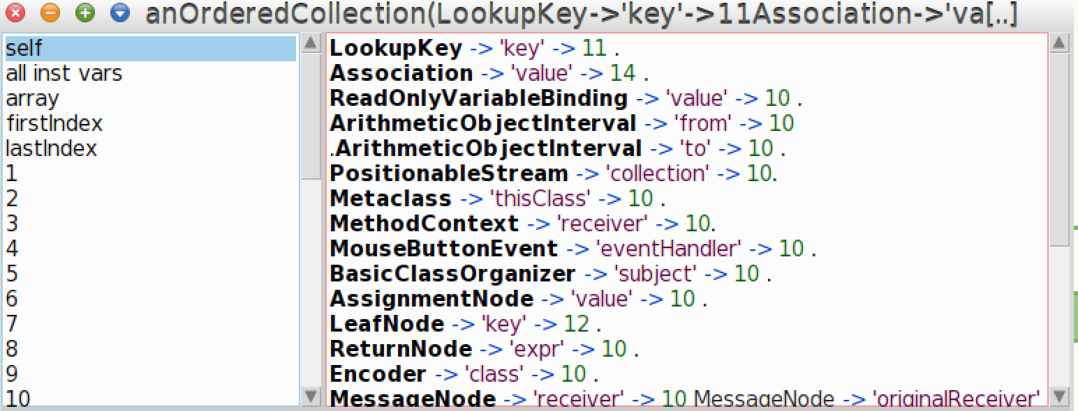
InstanceVariablesTypes allMegamorphicVariables

Slide 26
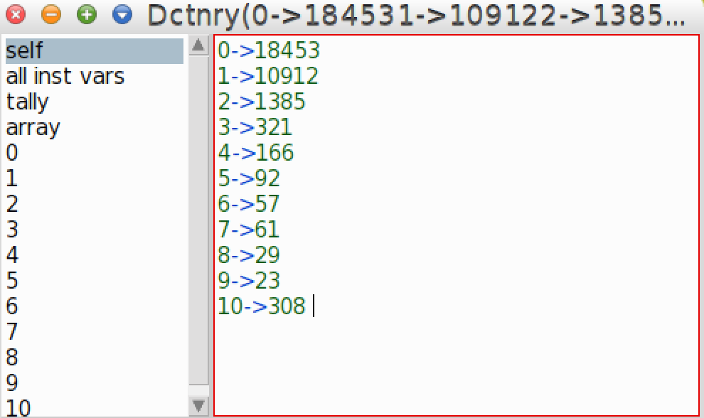
MethodVariablesTypes numberOfTypesForAll.

Slide 27
Performance
 | Typed VM | Stack VM | Difference
Aconcagua Tests | 37 ms | 22 ms | 1.6 x
Chalten Tests | 2400 ms | 2204 ms | 1.08 x
Refactoring Tests | 56382 ms | 39650 ms | 1.42 x
TicTacToe Tests | 3 ms | 2 ms | 1.5 x
Some Kernel Tests | 220 ms | 151 ms | 1.45 x
Average |  |  | 1.41 x
The important thing is that you do not notice it when you are programming

Slide 28
Memory
Typed Image - Full | Common Image | Difference
25 MB | 17 MB | 1.47 x

Slide 29
Tools

Slide 30
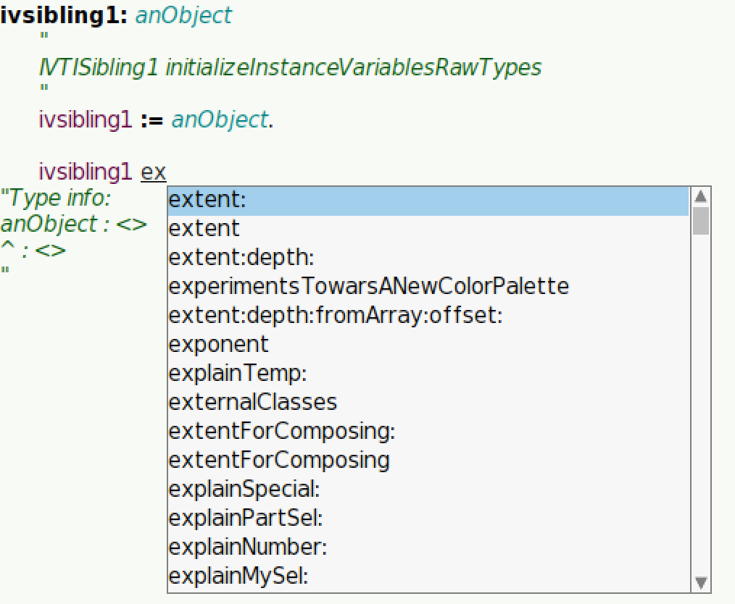
Browser Autocomplete

Slide 31
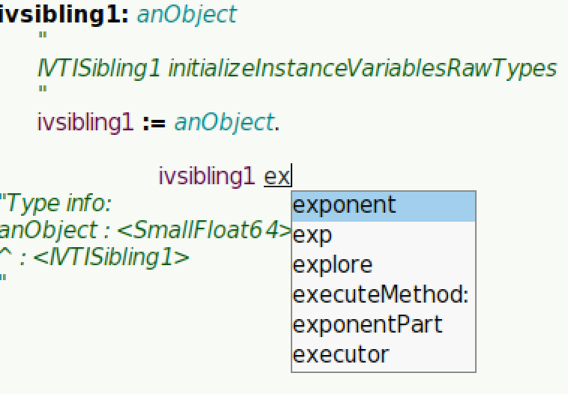
Browser Autocomplete

Slide 32
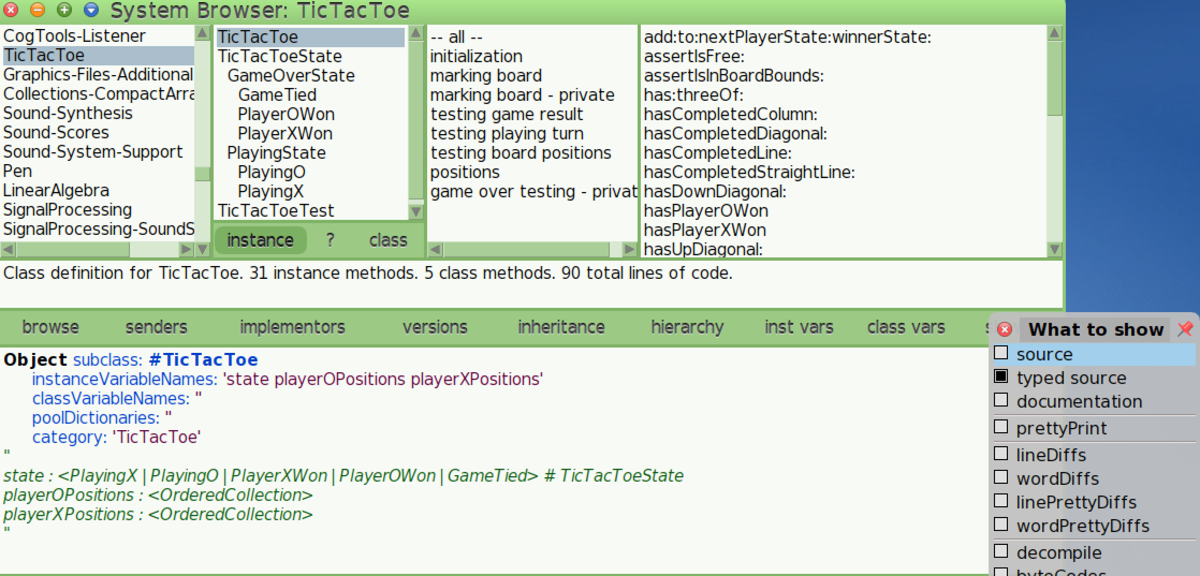
Browser: Show Types Source

Slide 33
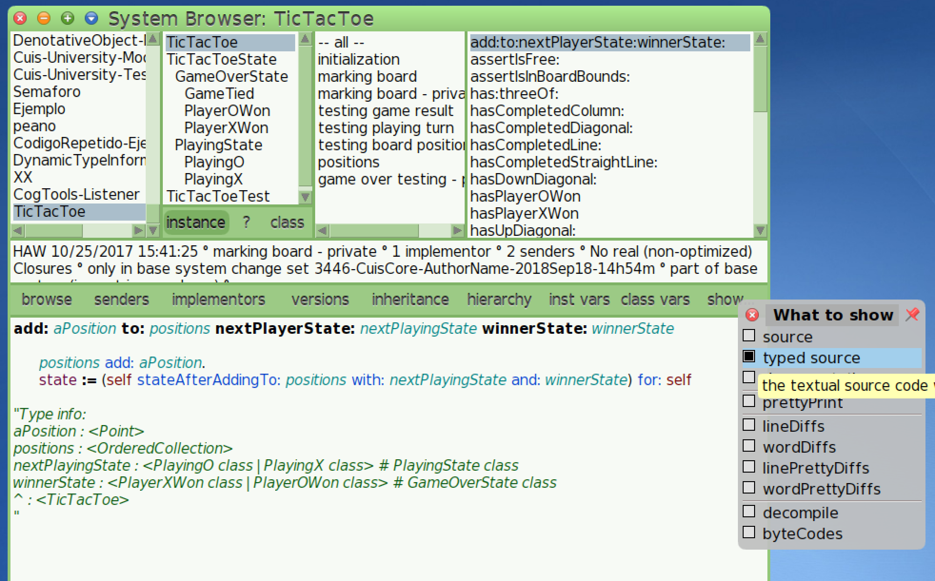
Browser: Show Types Source

Slide 34
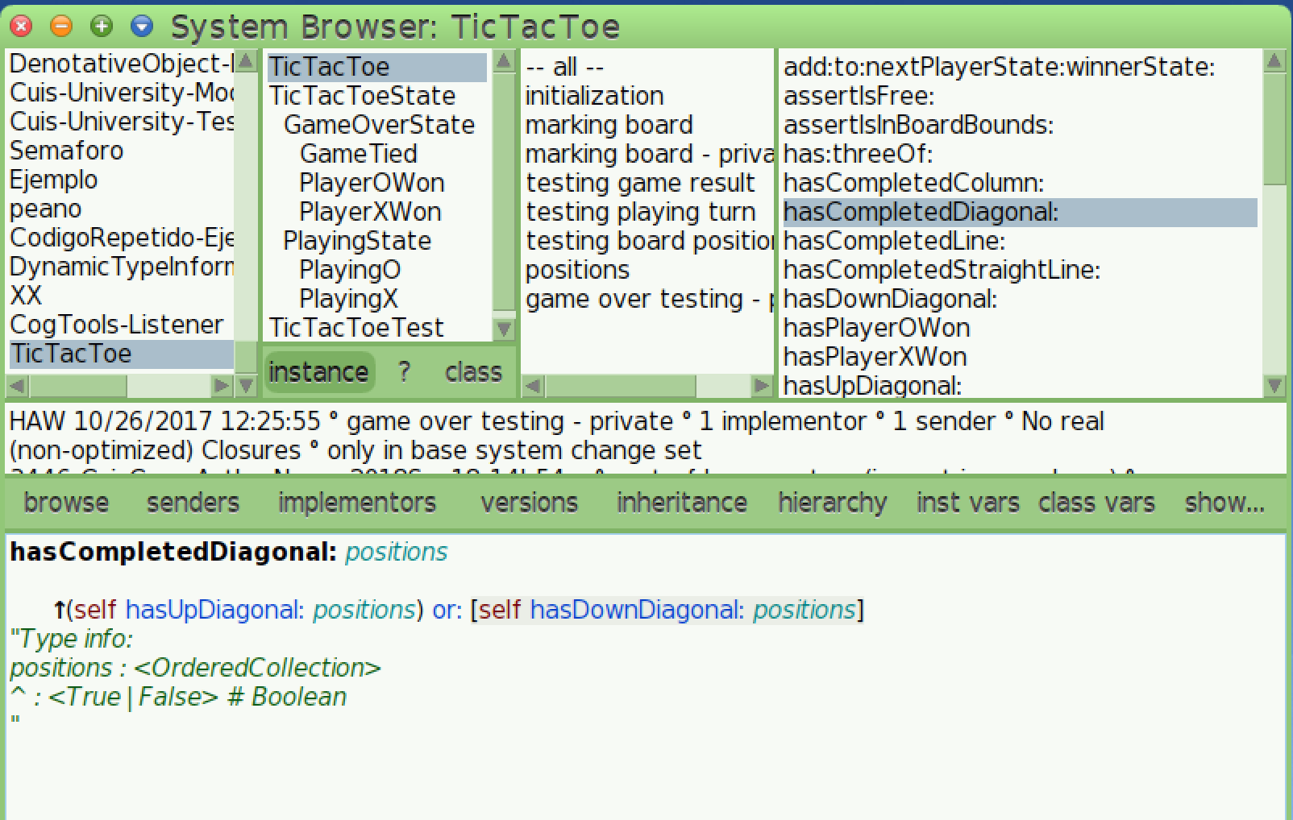
Browser: Show Types Source

Slide 35
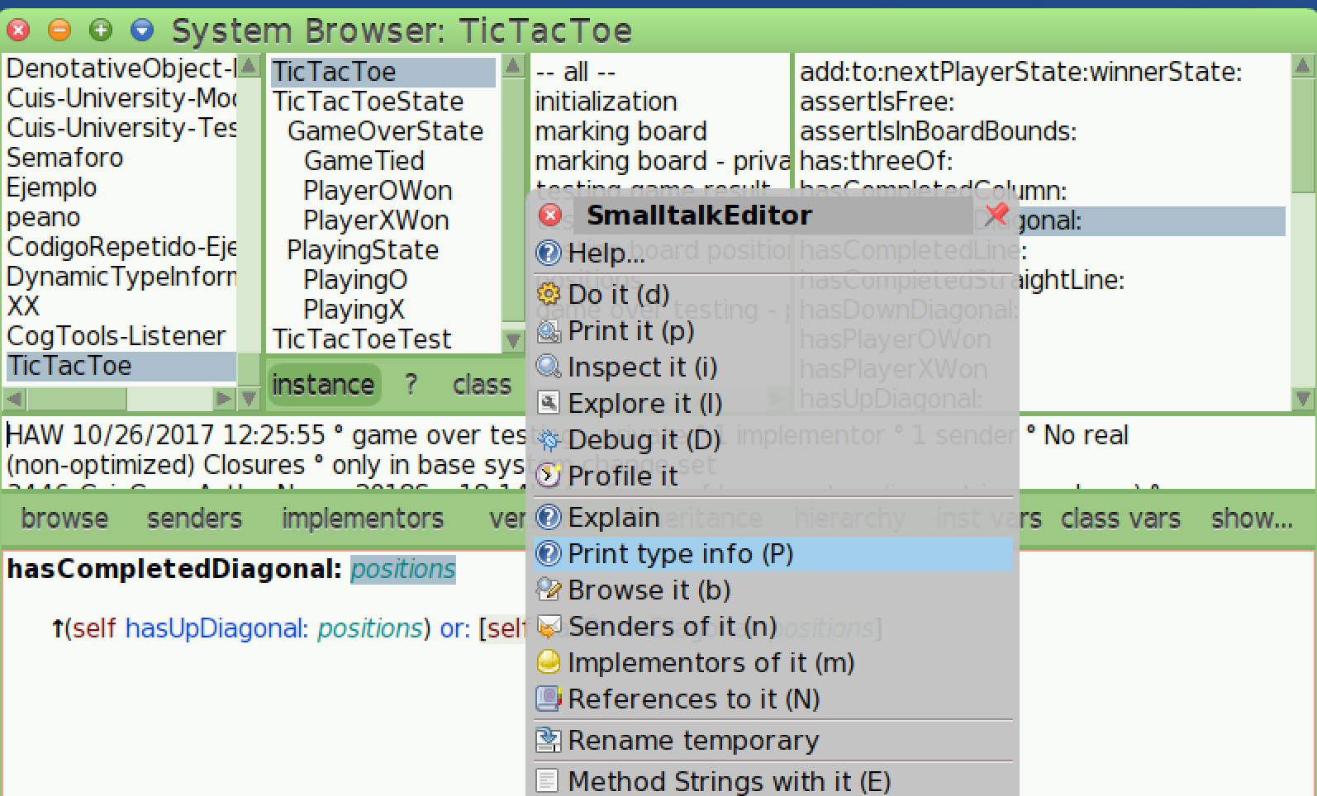
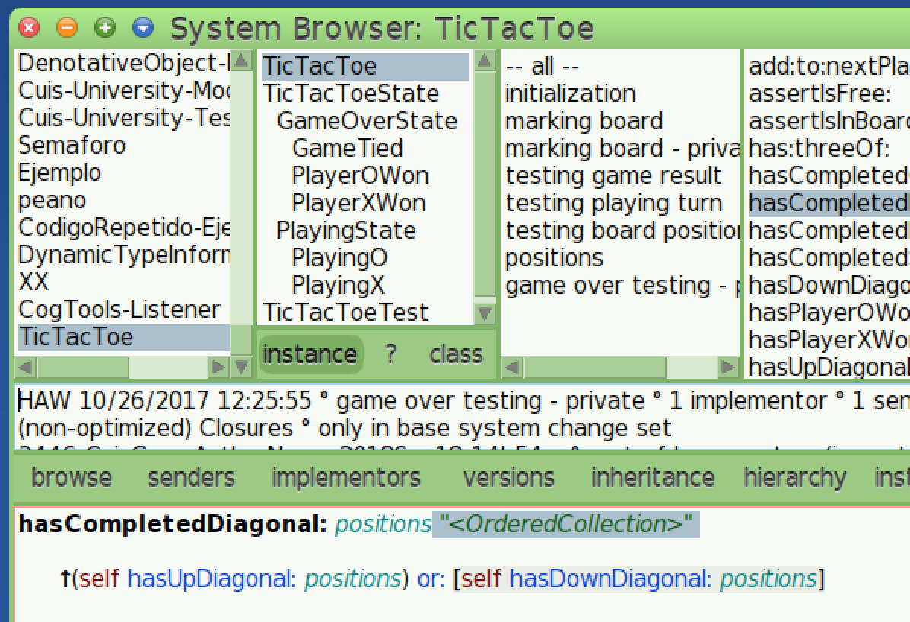
Browser: Show Types Source

Slide 36
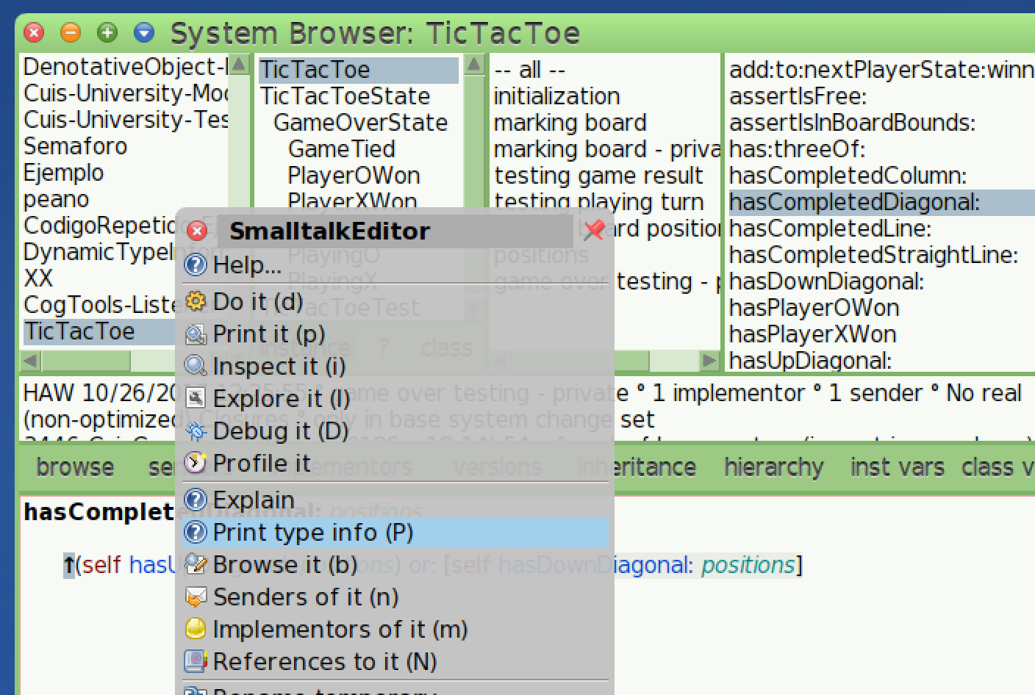
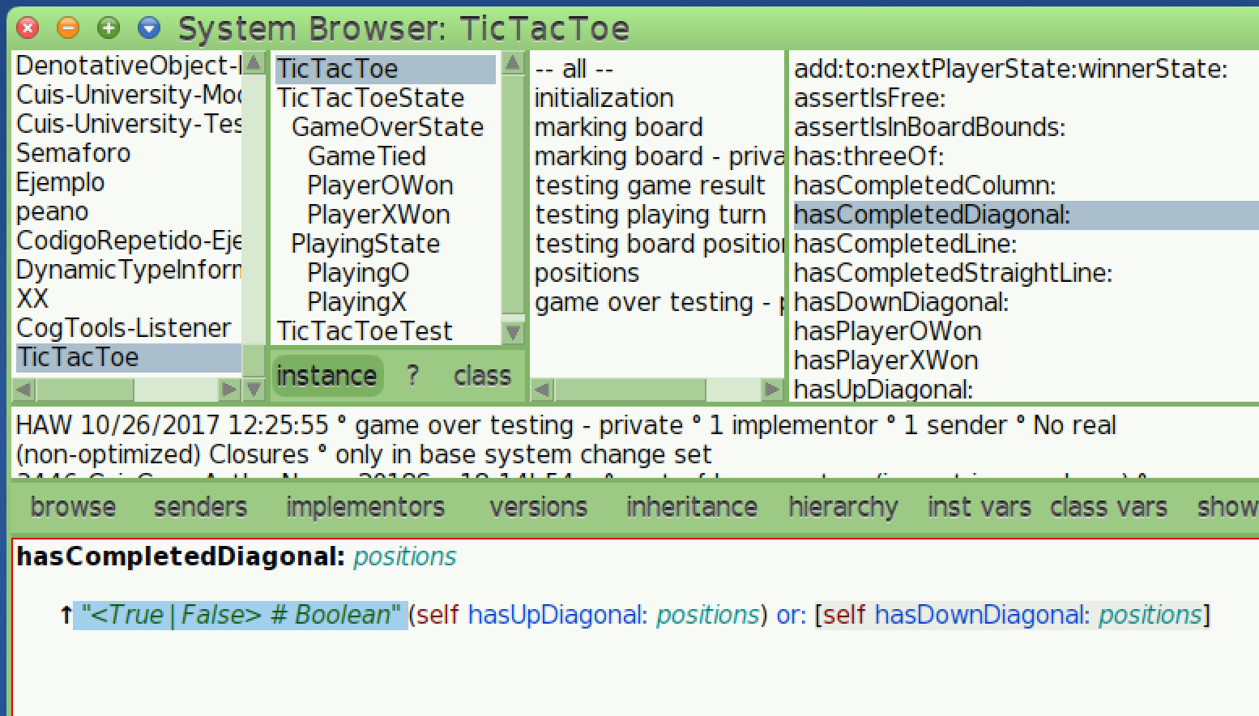
Browser: Show Types Source

Slide 37
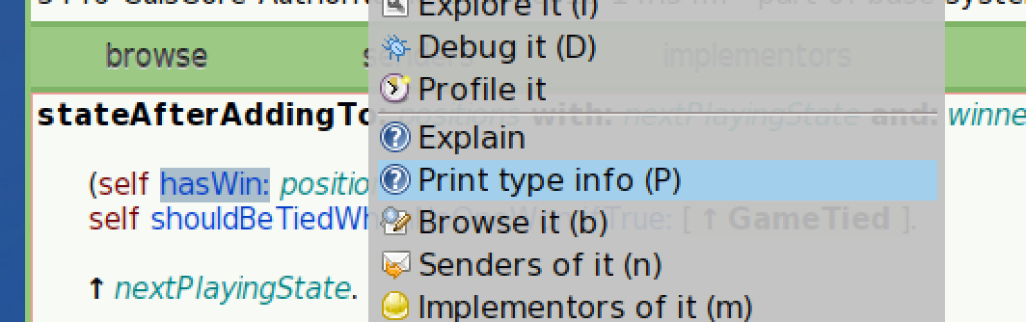
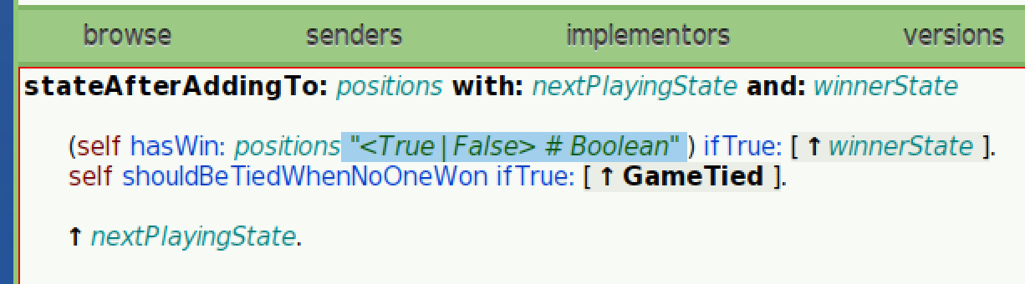
Browser: Show Types Source

Slide 38
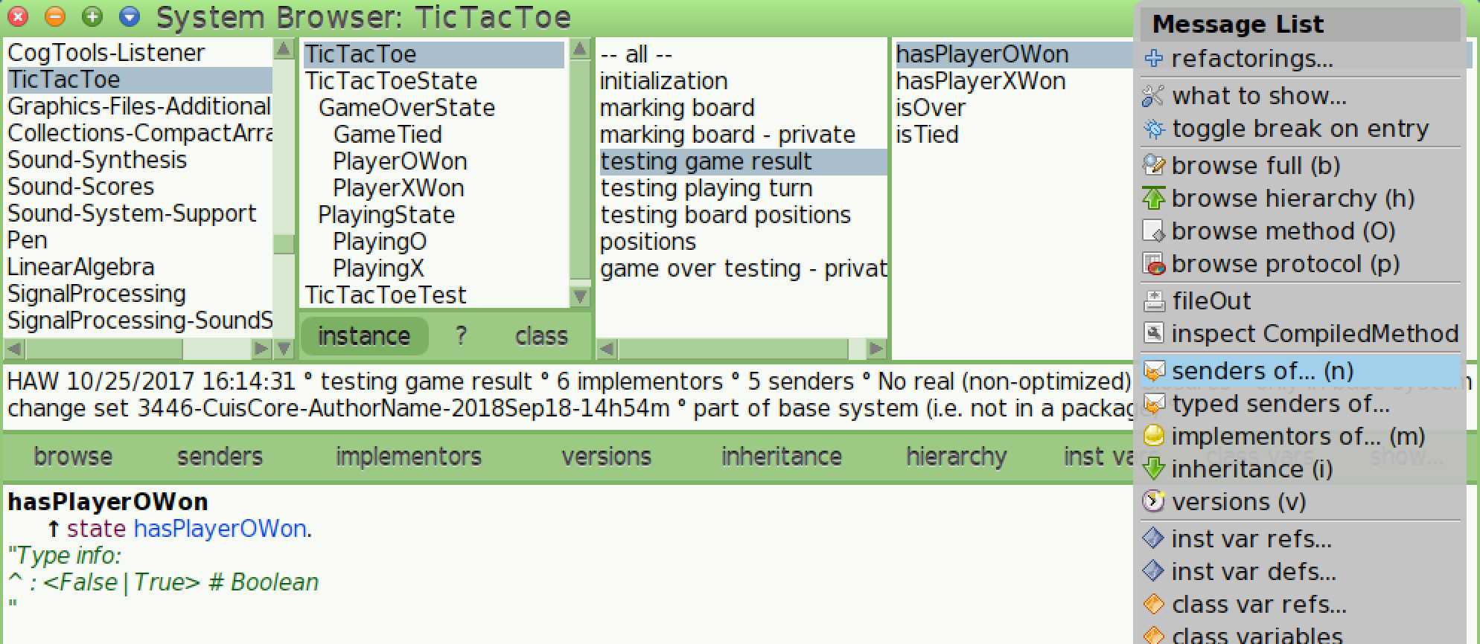
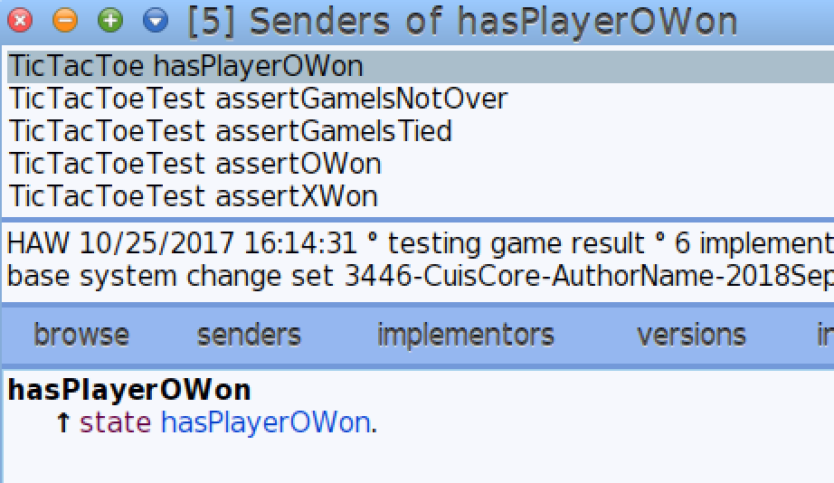
Typed Senders

Slide 39
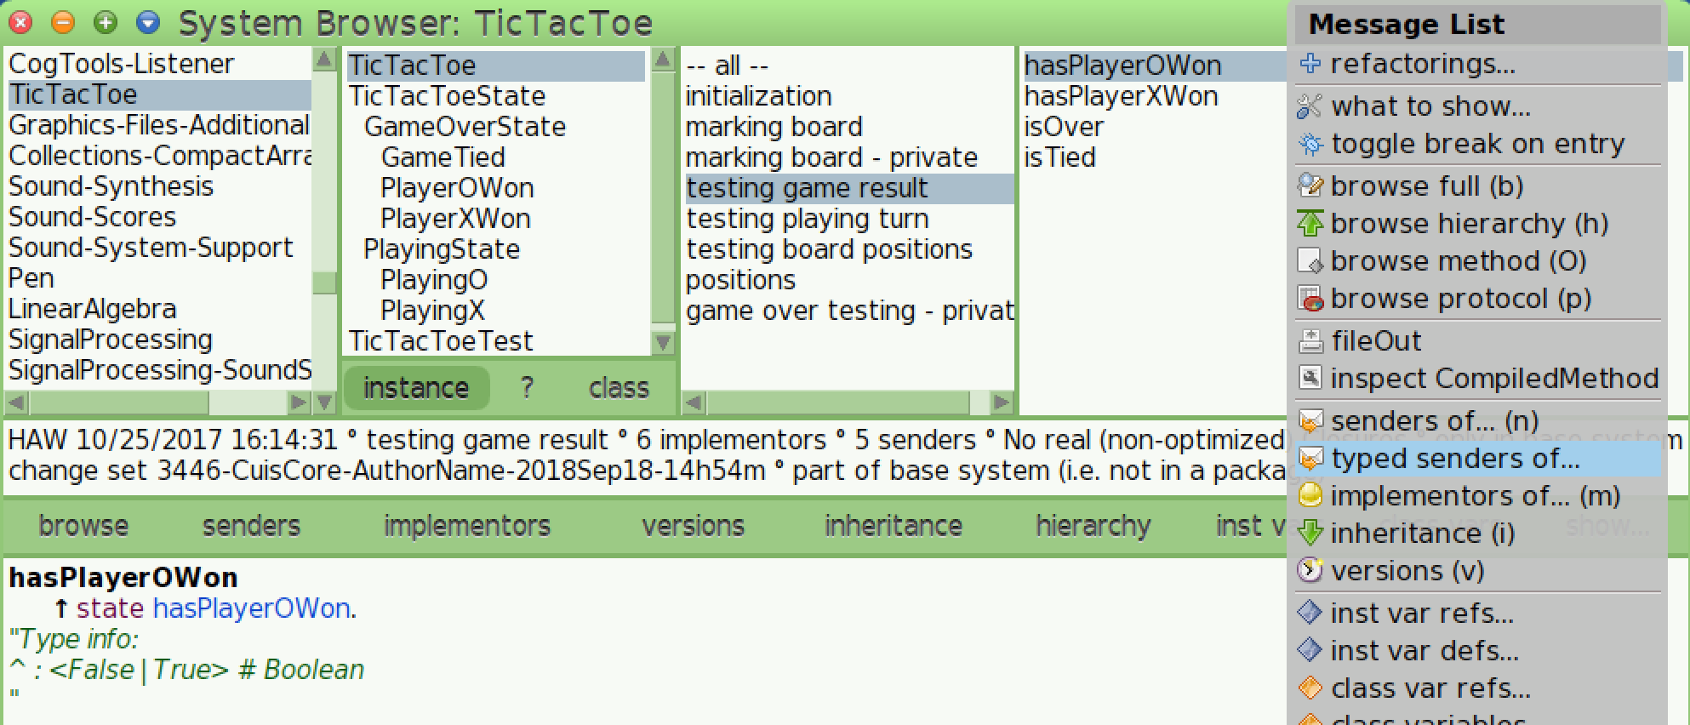
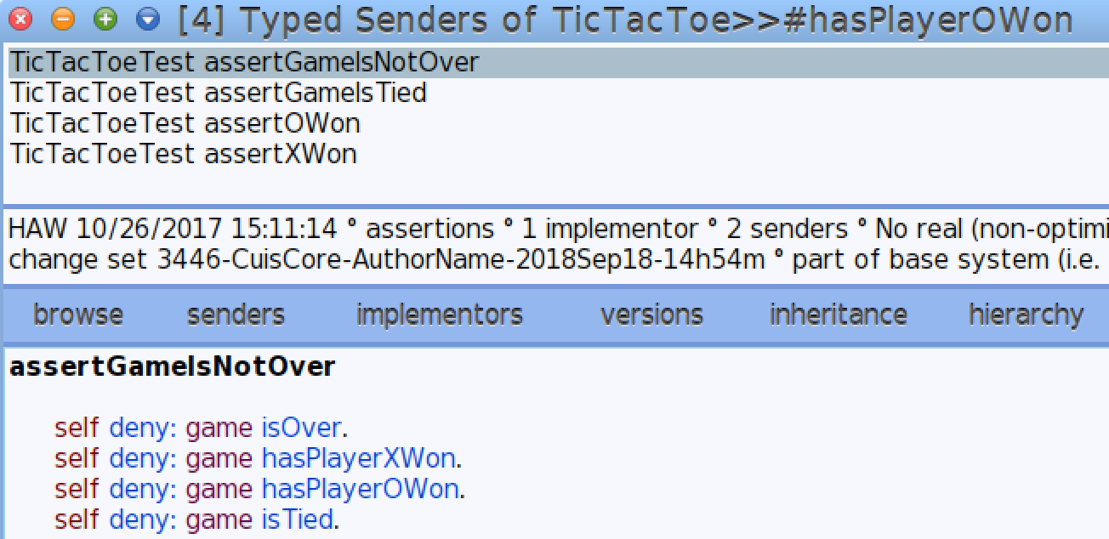
Typed Senders

Slide 40
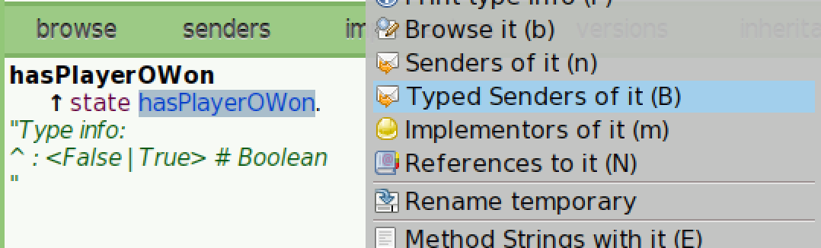
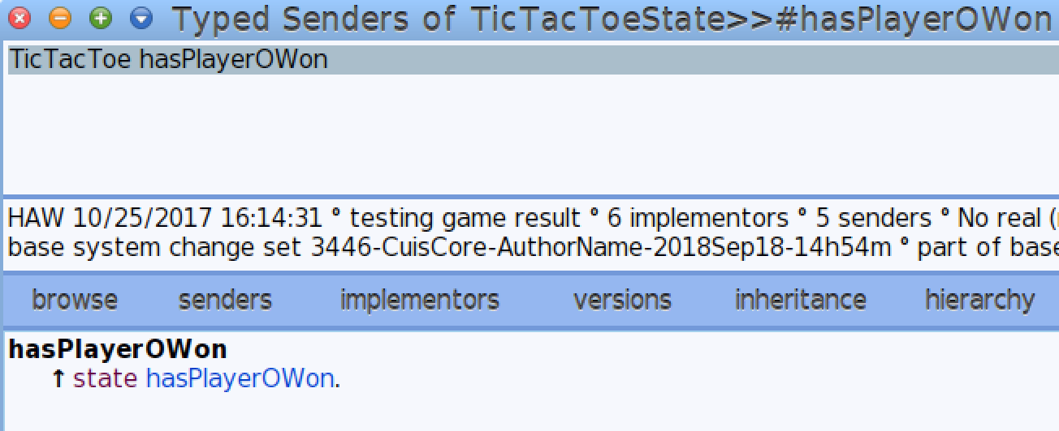
Typed Senders

Slide 41
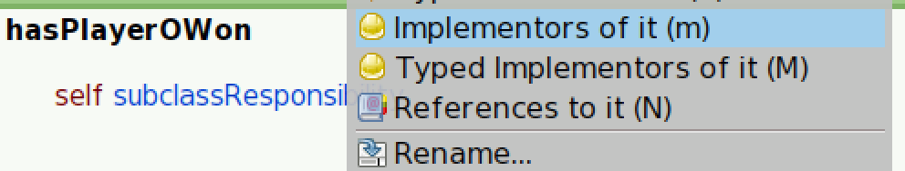
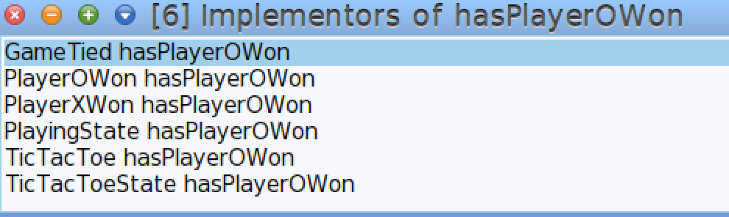
Typed Implementors

Slide 42
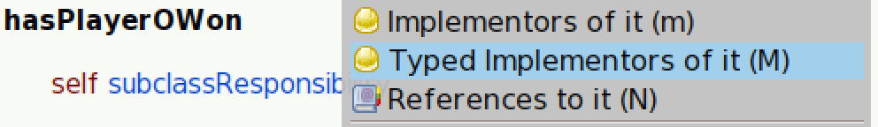
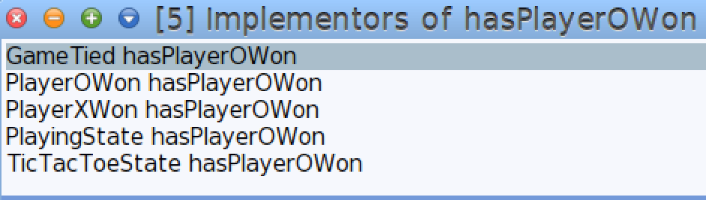
Typed Implementors

Slide 43
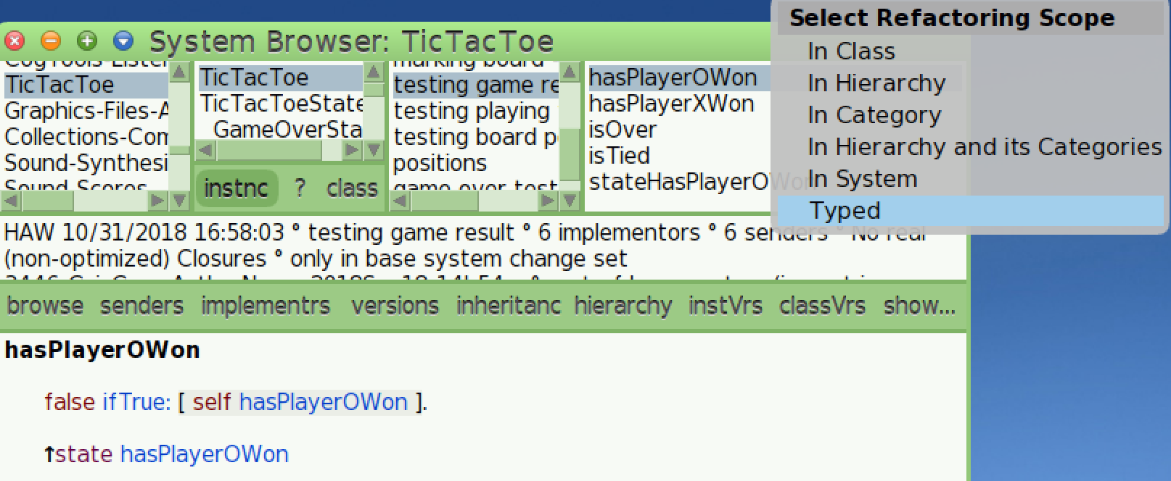
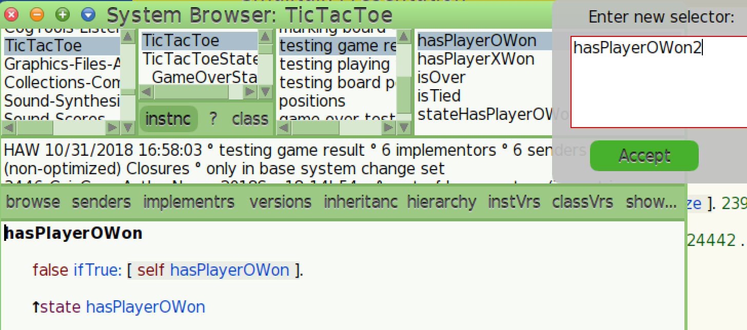
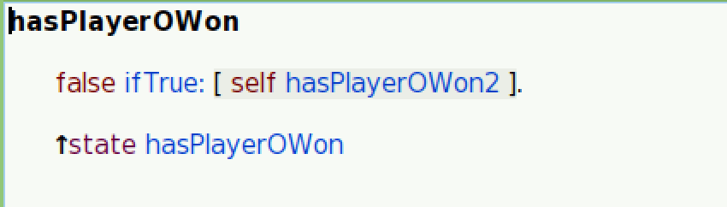
Typed Rename Selector

Slide 44
Comparison with other techniques
PIC
PIC does not provide return type info
PIC’s are not in all message sends and they can disappear on VM demand
PIC’s are cheaper
Type Inference
Does not cover all cases
Slow
Annotated Types
The programmer has to explicitly do it
The programmer has to explicitly maintain it, and we know what happens with documentation
It is very difficult to annotate all Smalltalk and why should we do it if Smalltalk can do it for us ☺

Slide 45
Some conclusions

Slide 46
It is a very simple technique that can put Smalltalk one step ahead of any other dynamically typed language like Python, Ruby, etc.

Slide 47
It is not a killer app but a killer feature!

Slide 48
We should not be afraid of this “typing technique”. It is not to stop us from doing something (like in Java, C#, etc.), it is to give us more info an help us

Slide 49
Feeling: When you start using it, you don’t want to loose it

Slide 50
Type info could be use in production with a no typed VM (not avised)

Slide 51
Future Work

Slide 52
On the VM
Store type info for blocks variables
Store type info for temporaries referenced from blocks
Store type info on primitives
Support for Parameterized typed is needed for collections, association, etc. (Collection<T>, Association<K,V>, etc.)
Implement this on the Cog VM (Currently it is implemented on the Stack VM)

Slide 53
On the Image
When changing a class, type info is lost and raw types no initialized
When changing a method, same thing
Support for Parameterized types
When debugging type info is not stored (the VM does not run the code)
What happens if a type of object is not assigned anymore to a variable?
A lot to refine and work in the tools

Slide 54
Crazy ideas
Can we optimize the method lookup with this info?
Could the compiler generate an explicit call (special bytecode) instead of a method lookup for some cases?
Could the compiler generate the PIC’s instead of the VM?
Could the compiler generate VTBL? (not like it, but we should do some research on that)
A technique to see for uncovered methods?
A dynamically type checker!
And much more!!
People interested on writing a thesis let me know!

Slide 55
Next steps
Look for time to invest on it! (Funding!!)
Finish the work in Cuis, use it, see implications, etc.
Port it to other Smalltalks (Pharo first)

Slide 56
Thanks!

